Slide 1
Feature Matching
CSCI 4150/6050: Computer Vision

Slide 2
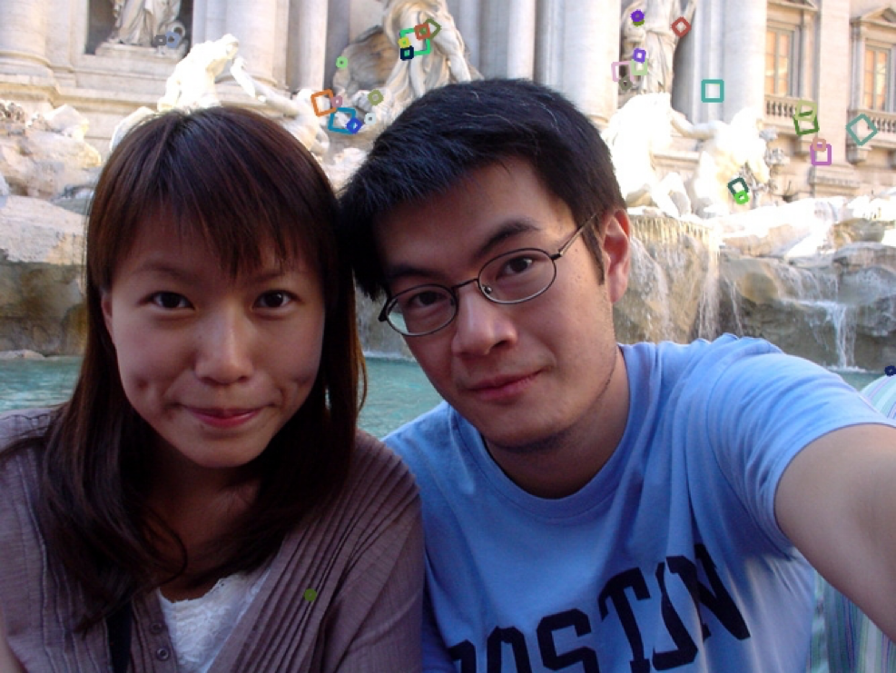
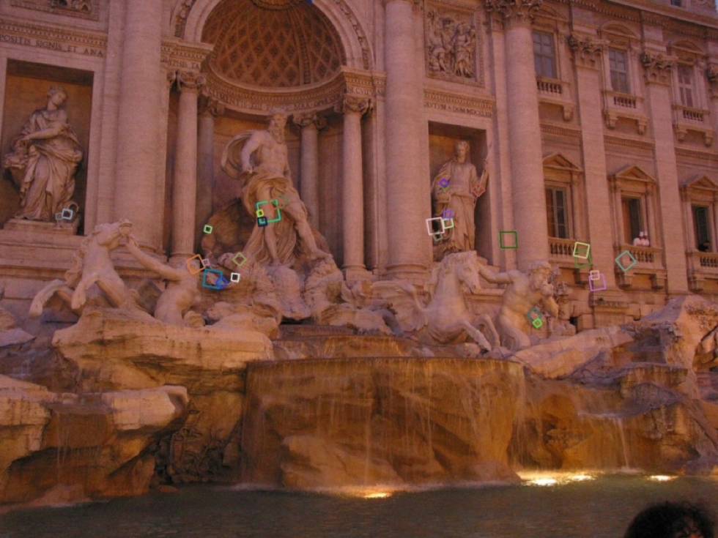
Recap: SIFT Descriptor
Extraordinarily robust matching technique
  Can handle changes in viewpoint
    Up to about 60 degree
    out-of-plane rotation
  Can handle significant changes in illumination
    Sometimes even day vs. night
  Fast and efficient—can run in real time
  Lots of code available

Slide 3
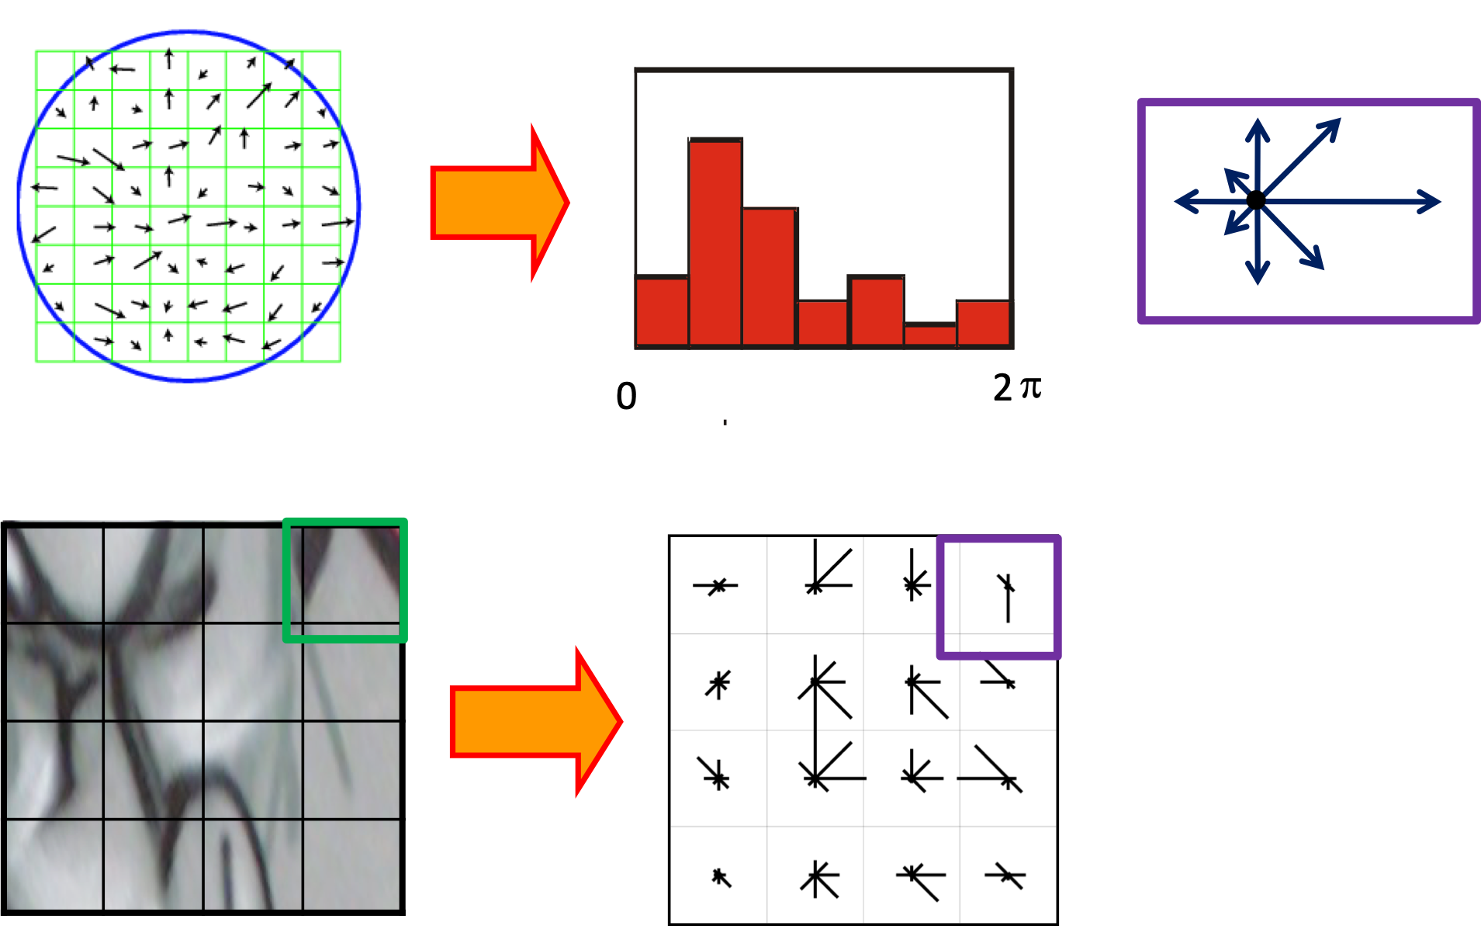
Scale-Invariant Feature Transform (SIFT)
Use histograms to bin pixels within sub-patches according to their orientation.

Slide 4
Once you have good feature points and descriptions, what do you do with them?

Slide 5
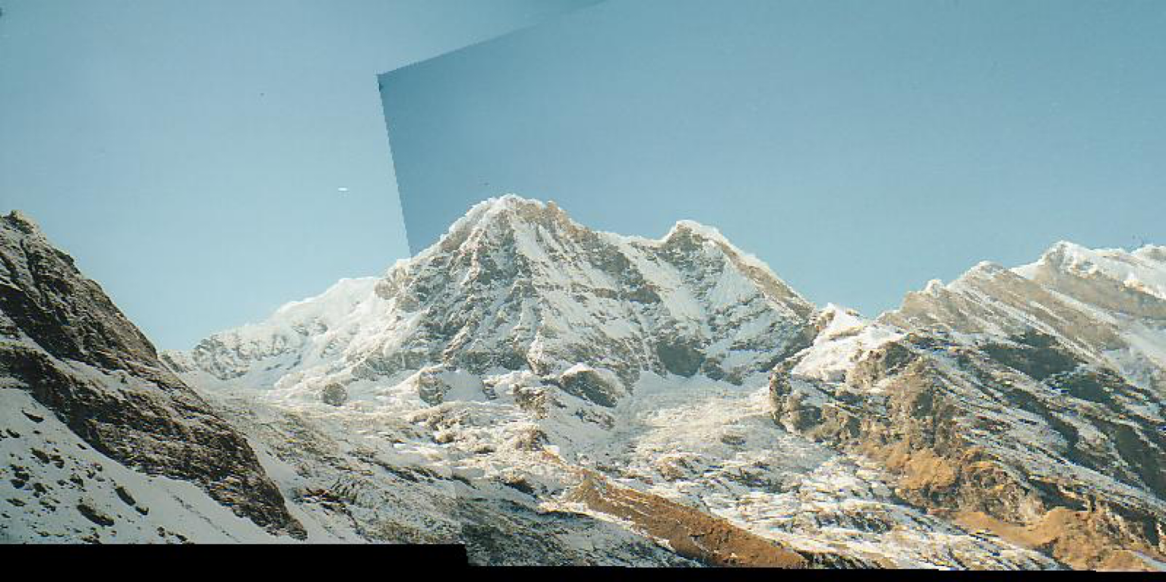
Applications of Feature Points
Image Stitching (Panoramas)
Motion Tracking
3D Reconstruction
Mobile Robot Navigation
Facial Recognition
And much more…

Slide 6
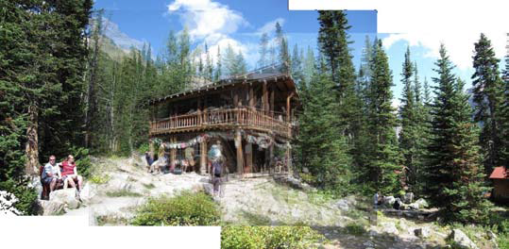
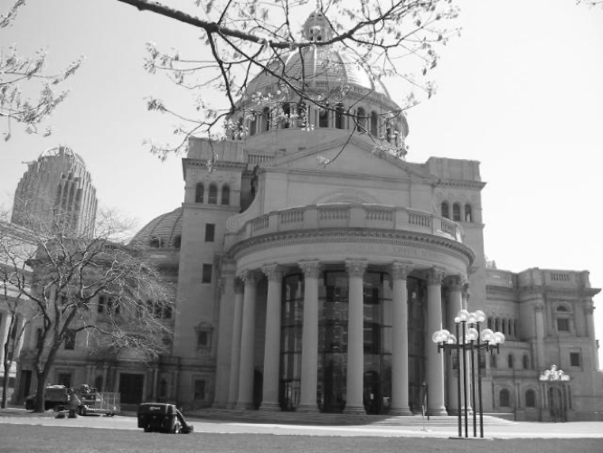
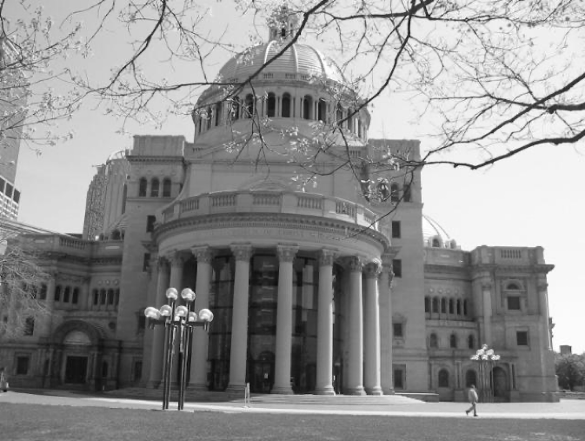
Image Alignment and Stitching
Alignment - Warp one image to match another so their content aligns
Stitching - Compositing images together after the warping. Used for panorama creation.

Slide 7
Alignment / Registration
Choose the set of transformation parameters that causes the images to align “best”
Also called image registration

Slide 8
Feature-based Alignment
Steps
  Find feature points in each image
  (already talked about)
  Match feature points between images
  using the descriptors eg cosine similarity
  Solve for the transformation that best maps the matching feature points to each other ie homographies for warping
  If stitching, warp one image and composite it with the other.

Slide 9
Recap: Homographies
If two cameras take pictures of a plane from different viewpoints,
  The projection of the plane to each camera is a homography
  The transformation of points from one picture to the other is also a homography!

Slide 10
Recap: Homographies
Eight free parameters
A pair of matching points provides two constraints (one for x, one for y)
Four points provides eight equations to solve for eight unknowns
Called the 4-point algorithm

Slide 11
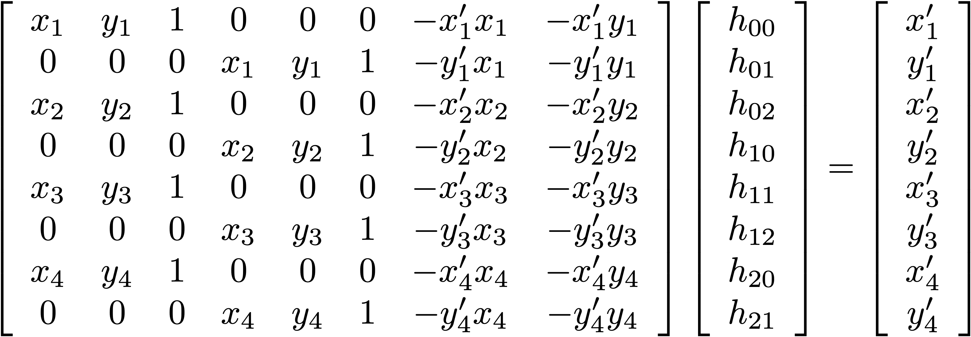
The Four-Point Algorithm
$A$
$x$
$b$

Slide 12

Caution: Avoid Co-Linear Points
Solution fails if any 3 of the 4 points are co-linear
(the matrix in the 4-point algorithm becomes singular)
Don’t even get close to co-linear!
(badly conditioned)
Good:
Bad:

Slide 13
Making It More Robust
What if the point positions are noisy?
  Discrete pixel sampling
  Noise
  Error
Solution: get more points!
Leads to an overconstrained system
Solve using least-squares solvers
  Linear (e.g., pseudoinverse)
  Nonlinear (e.g., Levenberg-Marquardt)
    requires starting point — seed with four-point result or linear least-squares solution

Slide 14
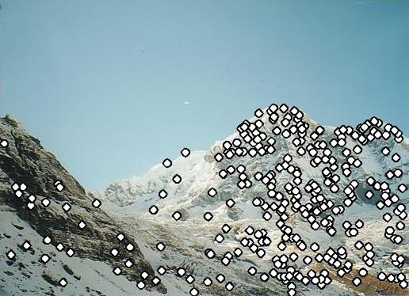
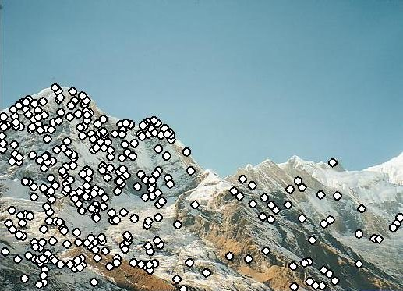
Step 1: Find feature points
How do we know which 4 points to pick because sift gives us all these interesting points in the image.
Usually use SIFT features in the two images
Source: L. Lazebnik

Slide 15
Step 2: Match features
Ie take a feature point on one side, compare to all the point in the right image and find the best match using eg L2 norm. The only issue is there is noise ie the diagonal match
Lines that are definitely not matches.
How do know which features are the same between the two images?
Source: L. Lazebnik

Slide 16
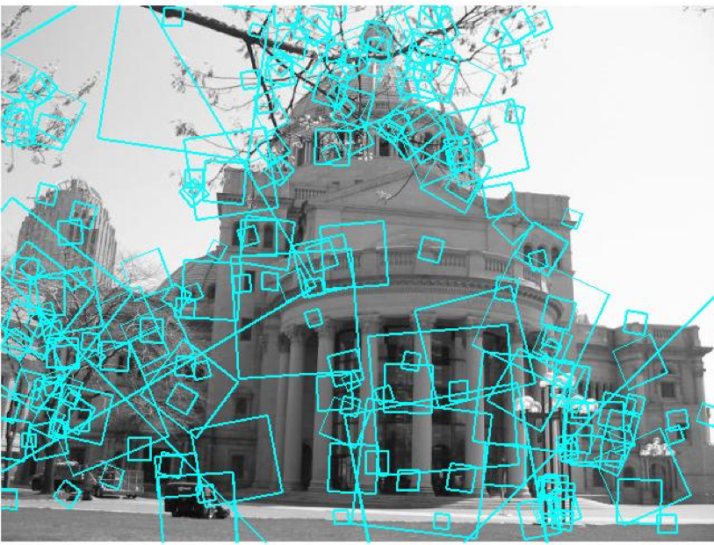
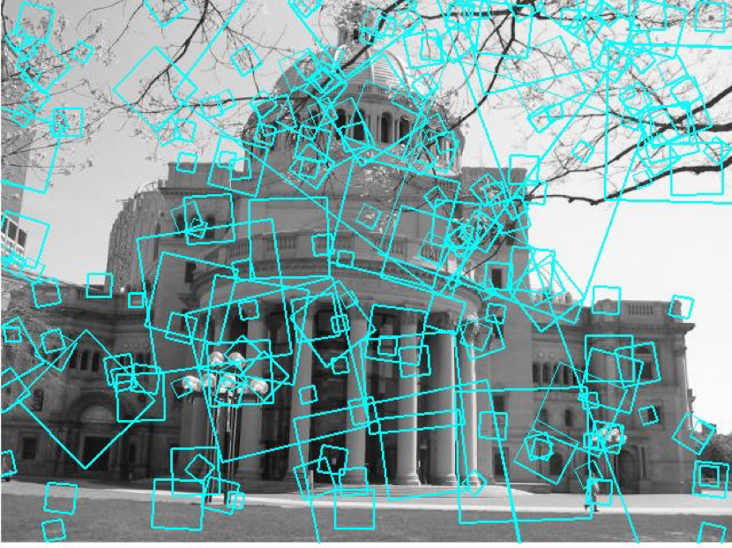
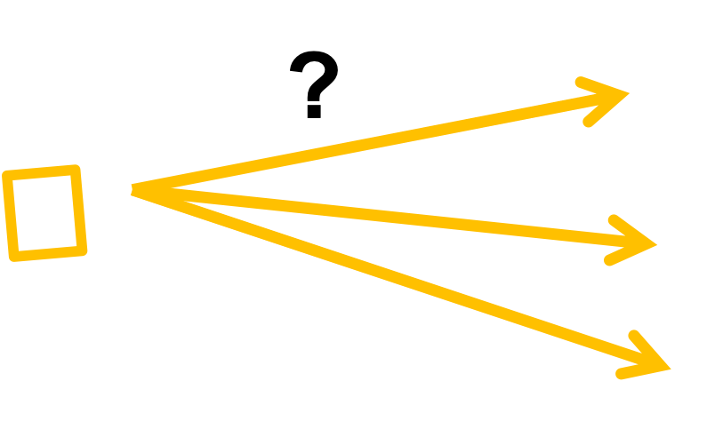
Matching Local Features
To generate candidate matches, find patches that have the most similar appearance
(e.g., lowest Sum of Square Distance (SSD) between neighborhoods, best-matching SIFT descriptors, etc.)
Simplest approach:
  compare them all
  take the closest
  (or closest k,
  or within thresholded distance,
  …)

Slide 17
Sum of Square Distance (SSD)
For 128-dimensional SIFT descriptor and SIFT descriptor , the SSD is
This is essentially the L2-Norm with out the square root.
Note: This is a common metric to use when you only need to compare relative distances. The square root is an unnecessary calculation and saves on computation time.

Slide 18
Whiteboard Discussion:
How do you find your best match?
Given 2 images,
1. image 1 and image 2 points have to individually agree that they are both each others best matches.
2. if in image 1 we have point 30, and it says its best match is point 4 on image 2, we do the ratio test. Ie ask it for other best options and if they are too close to each other in distance, we can conclude 30 is not a good feature point because it has too many similar non distinguishing matches in image 2. if the vice versa happened, then point 30 has a unique match and is good.

Slide 19


Ambiguous Matches
Given 2 images,
1. image 1 and image 2 points have to individually agree that they are both each others best matches.
2. if in image 1 we have point 30, and it says its best match is point 4 on image 2, we do the ratio test. Ie ask it for other best options and if they are too close to each other in distance, we can conclude 30 is not a good feature point because it has too many similar non distinguishing matches in image 2. if the vice versa happened, then point 30 has a unique match and is good.
At what SSD value do we have a good match?
To add robustness to matching, consider ratio: distance to best match / distance to 2nd best
  If low, first match looks good.
  If high, could be ambiguous match.

Slide 20
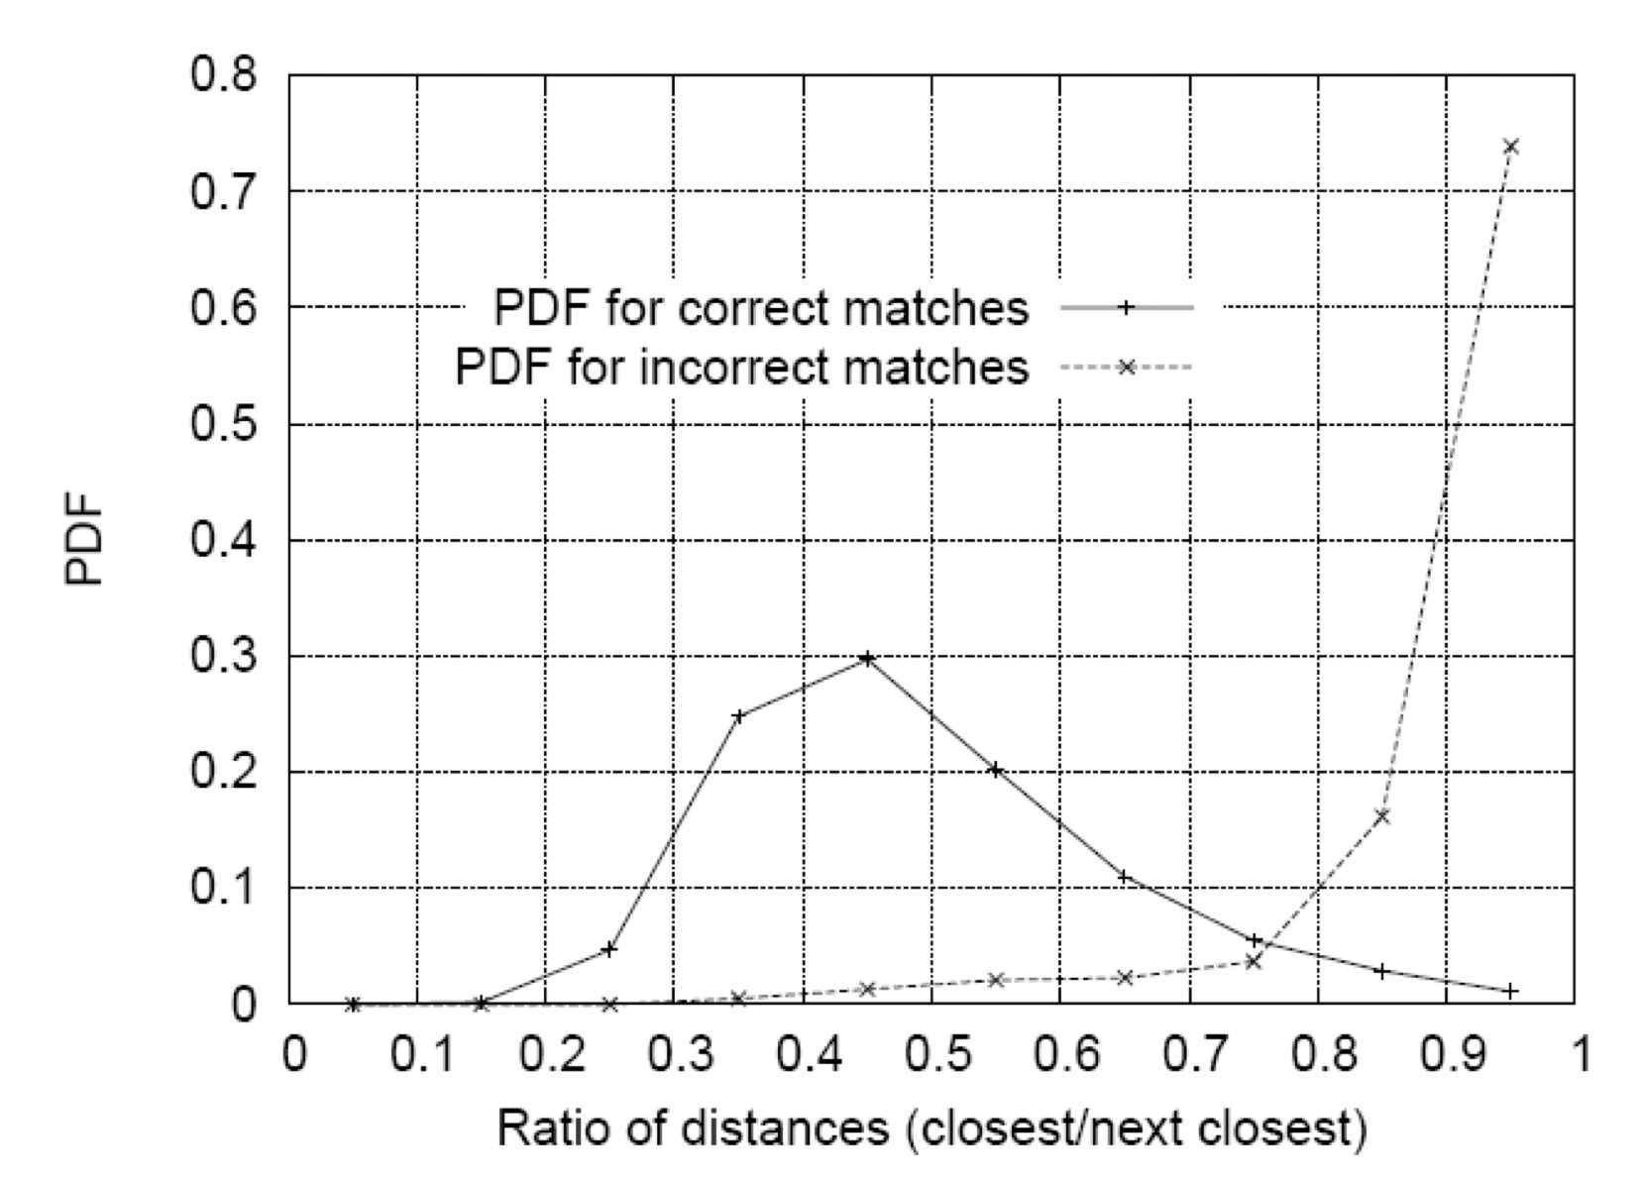
Matching SIFT Descriptors
Selecting good potential matches:
  Nearest neighbor (Euclidean distance) in whatever descriptors you’re comparing
  Compute ratio of nearest to 2nd nearest
  Threshold based on this ratio to reject ambitious matches
The remaining potential matches are sometimes called putative matches
Lowe, IJCV 2004

Slide 21
Let’s take a look in OpenCV…

Slide 22
Step 3: Determine the Homography
With the best matches now and less noise, we have to figure out what 4 points we should choose for the homography.
How do I know which four points to use when calculating the homography?
Source: L. Lazebnik

Slide 23
Dealing With Bad Matches
Some of the matches will still be wrong
  Ambiguous features
  Side-effects of greedy matching
  (Fully optimal pairing is NP-hard)
These are outliers—throw off the solution
How do we simultaneously
  Separate good matches from bad ones?
  Solve for best solution?

Slide 24
Detour: Fitting Data
Lots of problems involve fitting some sort of model to data
  Statistical regression
  Shapes (lines, circles, etc.)
  Spatial transformations
  Lots of other things…
RANdom SAmpling with Consensus is a more hypothesize-and-test approach

Slide 25
Problem: Outliers
Fitting when you know all the data points are correct is easy
Problem: there are lots of outliers
  Edge points that don’t lie on the shape you’re looking for (as with Hough)
  Mismatched points for transformations
  Noisy / bad data
Including the outliers when fitting the model throws the model off (e.g., least-squared error approaches)
Knowing what data are outliers is easy if you already know the correct model, but you don’t
How to find correct model and inliers simultaneously?

Slide 26
RANSAC
Key Idea: It is easier to determine a good model than it is to determine the exact outliers.
RANdom SAmpling with Consensus:
  Don’t start with whole set and find outliers
  Start with randomly chosen small subset and try to find inlier agreement (“consensus”)
  Not guaranteed to always work, but you can choose parameters so that it has a high probability of success

Slide 27
Example: Line Fitting
Algorithm:
  randomly select 2 of the n data points
  solve for the line passing through those 2 points
  see how many of the other points are within some distance threshold of that line
  repeat k times
  the line with the largest consensus set wins
  if desired, do a least-squares fitting of the line to only the winning consensus set

Slide 28
RANSAC
Suppose that you have
  a model that requires at least m points ie 4 in a homography
  n data points (generally n >> m), ie n is the sift feature matches
Algorithm:
  randomly select m of the n data points
  solve for the model that fits those m data points ie solve for homography here.
  see how many of the other data points fit that model to within some tolerance
  (the “consensus set”) – ie if 4 points in image 1 are matched to 4 points in image 2, then the other points in n not used as m should fit each other to an extent>
  repeat this some predefined number of times k
  the model with the largest consensus set wins!
  If desired, do an over-constrained fitting of the model to only the winning consensus set

Slide 29
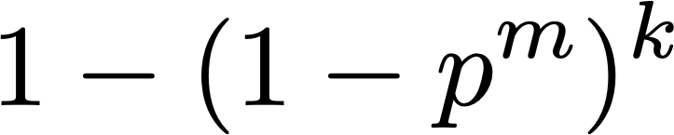
Why Does RANSAC work?
Suppose:
  a model that requires at least m points
  n data points (generally n >> m)
  p portion of the n points are inliers
  k iterations
What is the probability of success?
The higher the number of iterations, the higher probaiblity of success we get.

Slide 30
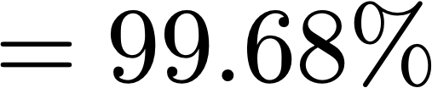
Why Does RANSAC work?
Going back to our line example:
  m = 2
  n = 100
  p = 50%
  k = 20
What is the probability of success?

Slide 31
How the Parameters Affect the Probabilities
  n data points
  m points to fit model
  p portion inliers
  k iterations
irrelevant!
worse odds as m increases
better odds with more inliers
better odds with more iterations, but to get a particular probability eg 99, just flip the equation and compute k so you know the exact number of iterations to run to get that prob.

Slide 32
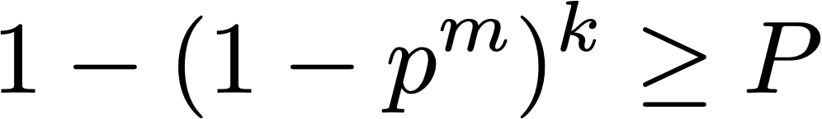
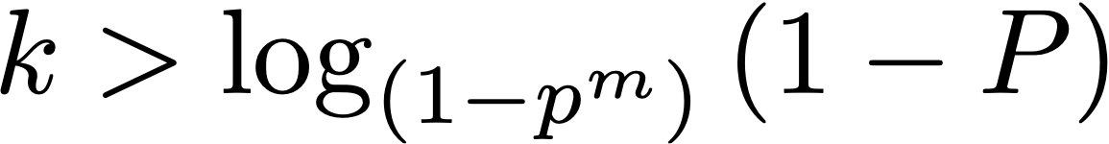
How Many Iterations?
Suppose:
  a model that requires at least m points
  n data points (generally n >> m)
  p portion of the n points are inliers
  P desired probability of success
How many iterations?
Can also be written using the change of base formula

Slide 33

How Many Iterations?
Example:
  m = 5 points to fit the model
  p = 30% inliers
  P = 99% desired probability of success
How many iterations?
K = log(1-0.99)/log(1-0.3^5)

Slide 34

Step 4: Compositing
Use transformation to warp one image to align with the other
Source: L. Lazebnik

Slide 35
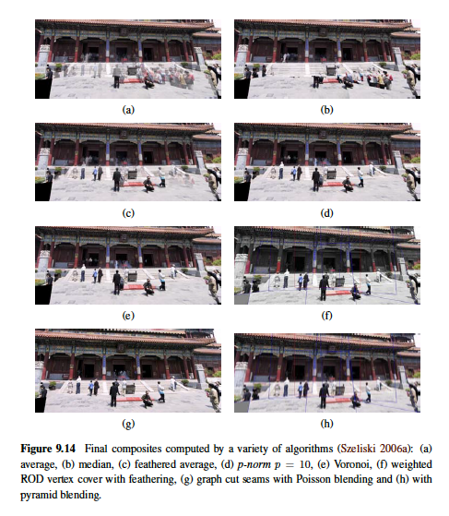
Compositing/Blending
Since the images overlap, you have to blend them together smoothly
Lots of options:
  Averaging
  Median (if more than two)
  Voronoi
  Gradient-domain blending
  And more….

Slide 36
Averaging
Simplest approach is to just average the different images in areas of overlap
May be more than two!
Can lead to ghosting artifacts
  Alignment errors
  Moving objects

Slide 37
Median
Remember that the median is less sensitive to outliers than the mean (averaging)
When objects are moving, they are outliers!
Idea: make sure you have at least three views of every part of the scene, and use the median to remove tourists, etc.

Slide 38
Voronoi
Use whichever overlapping pixel is closest to its own center
Good: only one source image for each pixel — no ghosting!
Bad: can lead to noticeable seams if there’s misalignment (but you can feather them a bit)

Slide 39
Gradient-Domain Blending

Slide 40
Gradient-Domain Blending
Gradients are adjusted between the images so the gradient moving from one image to another is closer to 0.
More on this later…

Slide 41
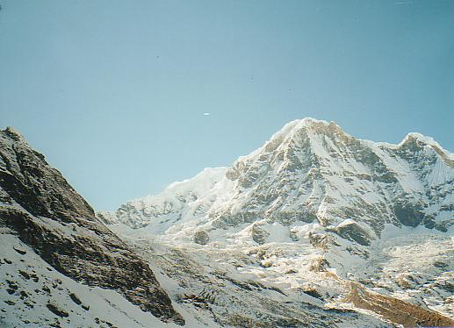
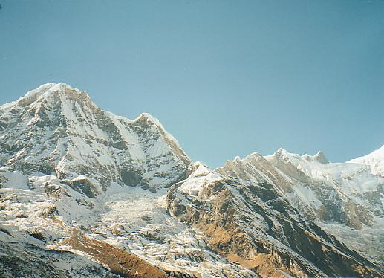
Putting It All Together
Source: L. Lazebnik

Slide 42
Putting It All Together
Extract features
Source: L. Lazebnik

Slide 43
Putting It All Together
Find putative matches
Source: L. Lazebnik

Slide 44
Putting It All Together
Employ RANSAC and 4-point algorithm
Source: L. Lazebnik

Slide 45
Putting It All Together
Use the largest consensus set to solve an overdetermined system and calculate the transformation (homography)
Source: L. Lazebnik

Slide 46
Putting It All Together
Use transformation to warp one image to align with the other
Source: L. Lazebnik

Slide 47
Accumulated Error
Problem:
  Align image 1 to image 2 — a little bit of error, but not bad
  Align image 2 to image 3 — a little bit of error, but not bad
…
  Align image n-1 to image n — a little bit of error, but not bad
  How far off is image 1 from image n?

Slide 48
Bundle Adjustment
Solution to accumulated error and drift: one big optimization!
  All of the images
  All of the feature point pairs (just keep inliers)
  Global optimization to find all of the homographies
This is called a bundle adjustment
Since a lot of the images have no overlap, the full system of equations is sparse,
hence sparse bundle adjustment or SBA (Triggs, et al.)
Can be done hierarchically:
  Bundle adjust a small overlapping subset
  Work to larger subsets and eventually the whole thing

Slide 49
Next Time…
More applications of feature matching

